Slide 1
The Romantic Life of Slayco Malfoy
By Gigi, Kate, Elijah, Masha, Spencer and Abigael

Slide 2
Our Data Source
For those who don’t know, Archive of Our Own, or AO3, is an extremely popular fanfiction site. Wikipedia states that it is a “nonprofit open source repository for fanfiction and other fanworks contributed by users. The site was created in 2008 by the Organization for Transformative Works and went into open beta in 2009. As of 6 November 2023, Archive of Our Own hosts 12,010,000 works in over 61,470 fandoms.”
AO3 actually compiles a lot of their own data and it’s open for use! So this is where our first data set was sourced from. It specifically has the number ID for each story, the tags, and the ship/pairing that the story is written about. Our other was found on reddit, and it only deals with Harry Potter stories, so it wouldn’t need to be cleaned

Slide 3
Our Process
We wanted to look at the most popular heterosexual ship versus the most popular homosexual ship, and cross reference which tags were most popular for each. The most popular ships were Draco x Harry, and Draco x Hermione.
Now that we had our data, both sets needed to be cleaned and sorted. The first one that AO3 themselves made, “works,” needed to be exclusively Harry Potter stories.
Then after that, we had to inner join the data by the top tags that both ships stories possess.
We then cleaned the tag groups and moved onto sentiment value sorting.

Slide 4
Sorting Tags into Intermediate Values
Now that we had our data, both sets needed to be cleaned and sorted. The first one that AO3 themselves made, “works,” needed to be exclusively Harry Potter stories.
Then after that, we had to inner join the data by the top tags that both ships stories possess.
We then cleaned the tag groups and moved onto sentiment value sorting.

Slide 5
Sentiment Values
A
B
C
D
Sexual
Romantic
Neutral
Unknown
Tags that are inherently sexual or describe sexually related
topics
Tags that describe the rest of the story content that are not sexual or romantic
Tags that describe or relate to romantic relationships
Tags that are handling the technicals of the posting itself or the author’s commentary

Slide 6
Our Findings

Slide 7
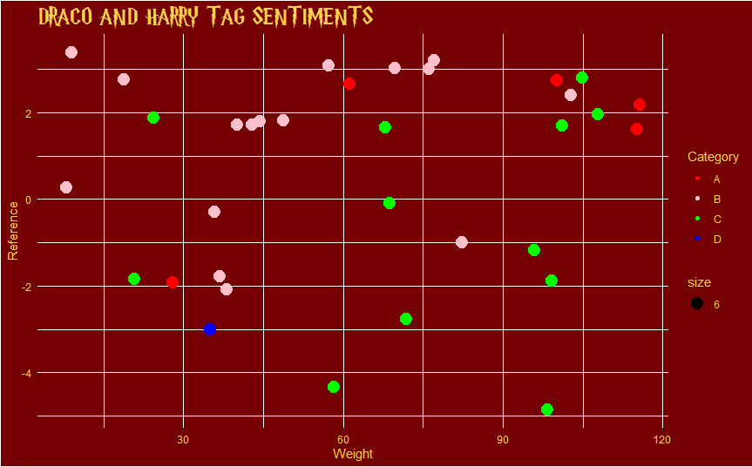
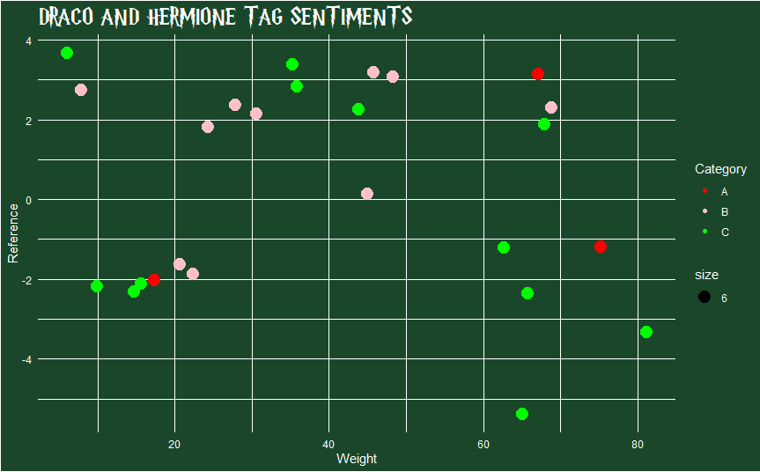
Drarry vs. Dramione

Slide 8
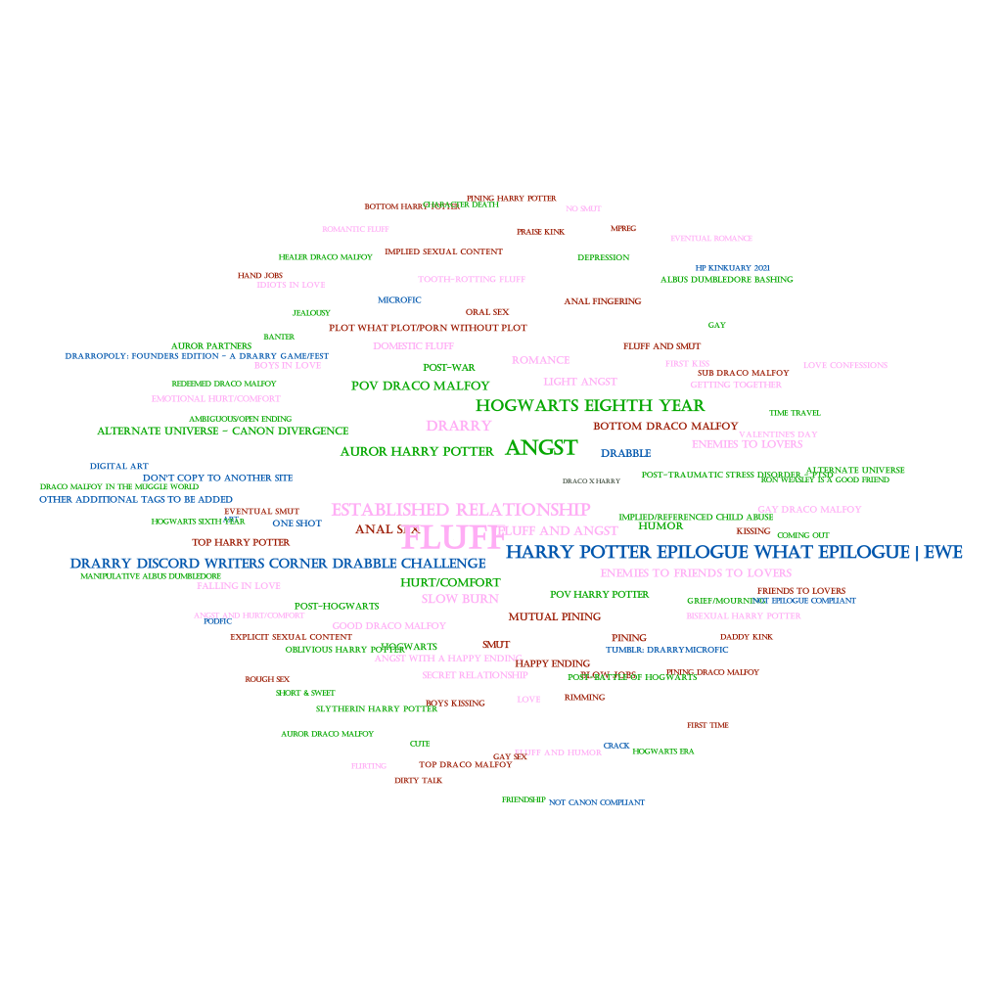
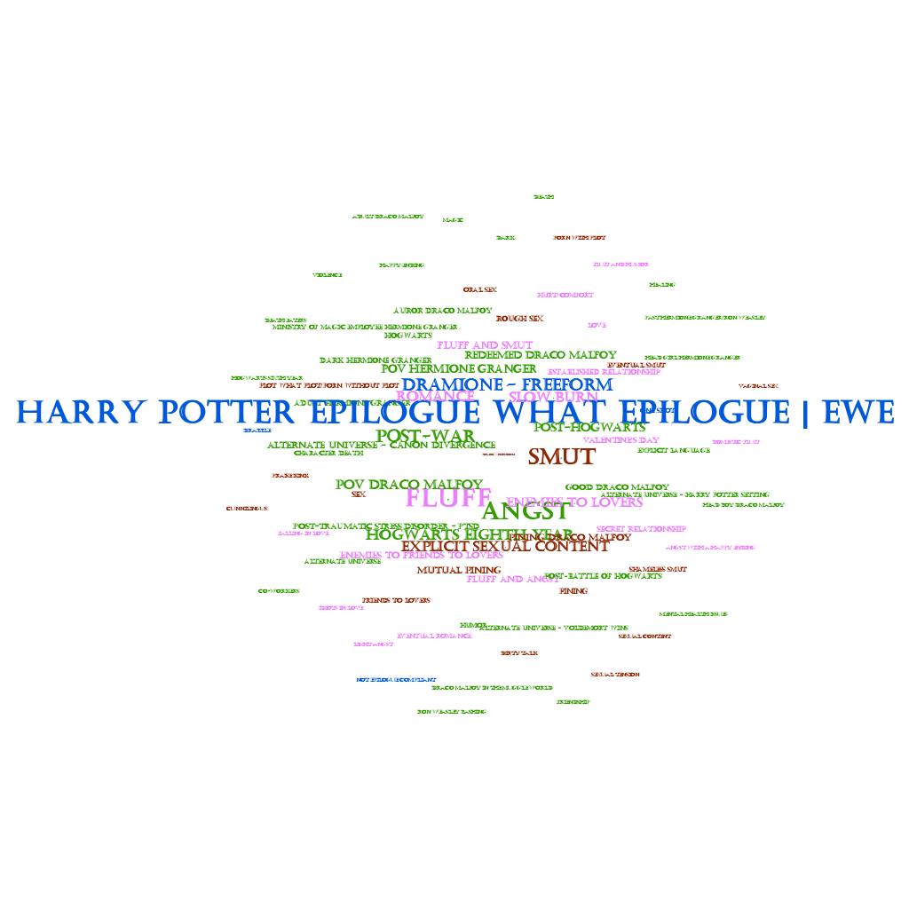
Drarry vs. Dramione

Slide 9
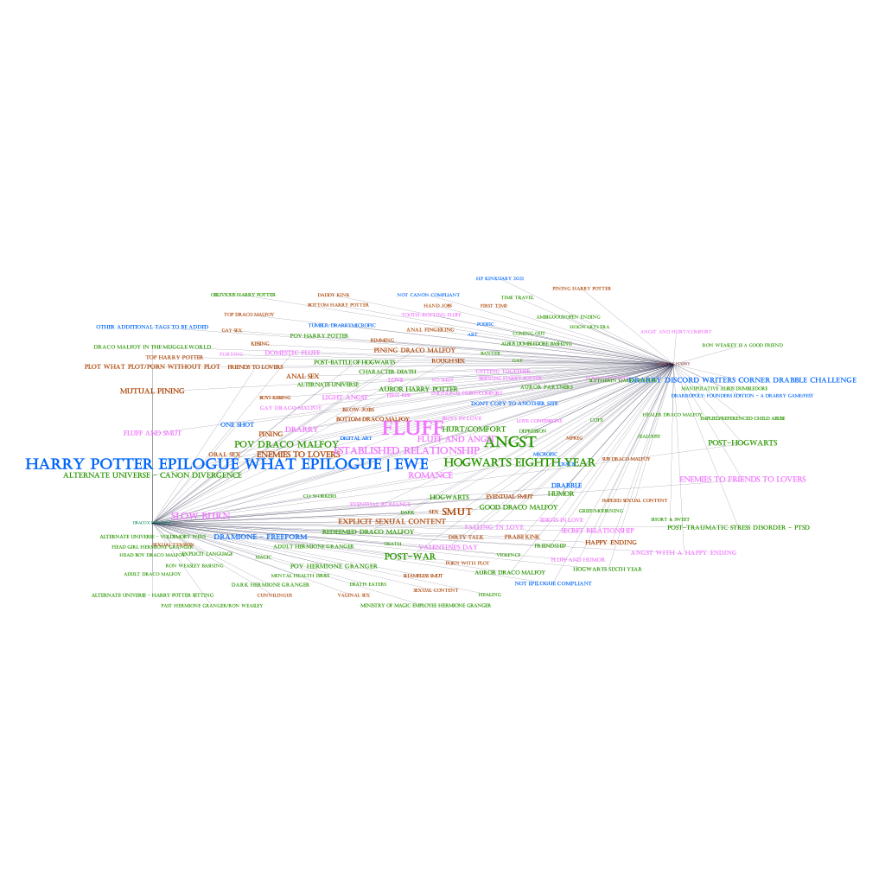
Combined Tags

Slide 10
Analyzing Our Results
Dramione
Both
Challenges
Drarry
Most popular trope: enemies to lovers
Even fluff to angst distribution
Much higher “love” tag
Most popular trope: enemies to friends to lovers
A lot more fluff
Twice as popular of a ship
Slightly higher sexual tag weight
Most popular POV: Draco
Even romantic/sexual tag ratio
High slow burn elements (eg. slow burn, pining, mutual pining)
Almost 100,000 combines DXH & DXHER fanfictions
Thousands of tags
Many tags mean the same things (eg. angst + hurt, fluff + romance, etc)

